Slide 1
How to use branch from Jira
The purpose of this powerpoint is to show you how to use a branch on jira. We will use the branch to update the README file and enter you name. The steps are just to show you the process, you can use the same method when working on your codes.

Slide 2
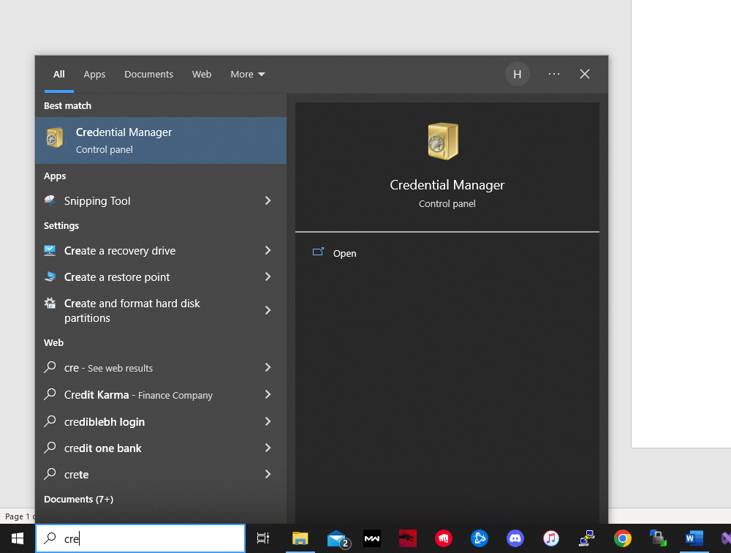
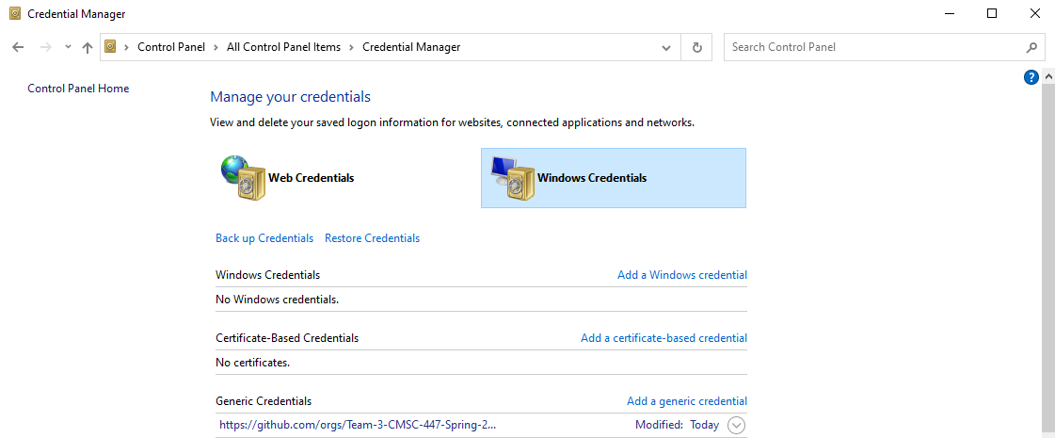
Install Gitbash and Update Credential Manager
Download gitbash https://gitforwindows.org/
In search bar open Credential manager and open it
In there select Windows Credentials and click “Add a generic credential

Slide 3
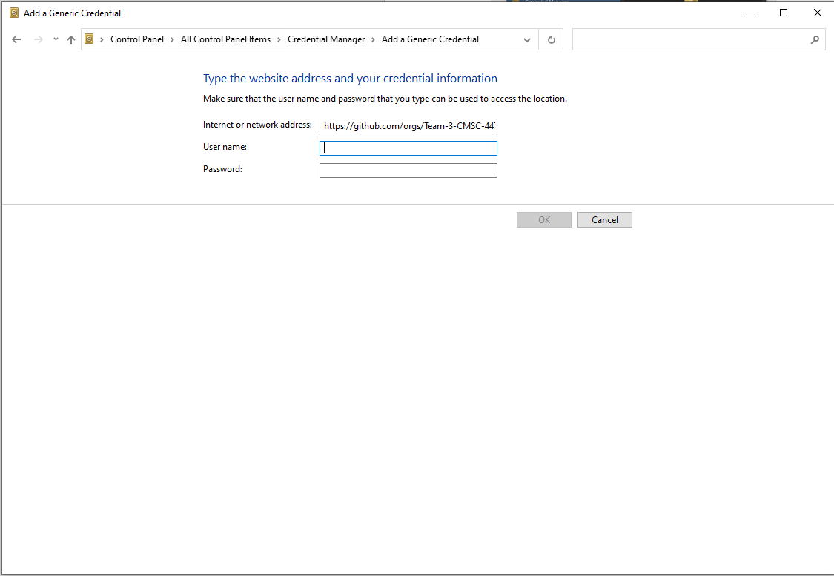
Credential Manager
Enter https://github.com/orgs/Team-3-CMSC-447 as the address
Use yourgithub login for username and password and click ok.
This will now allow you to use gitbash and clone any repositories from your github to your computer

Slide 4
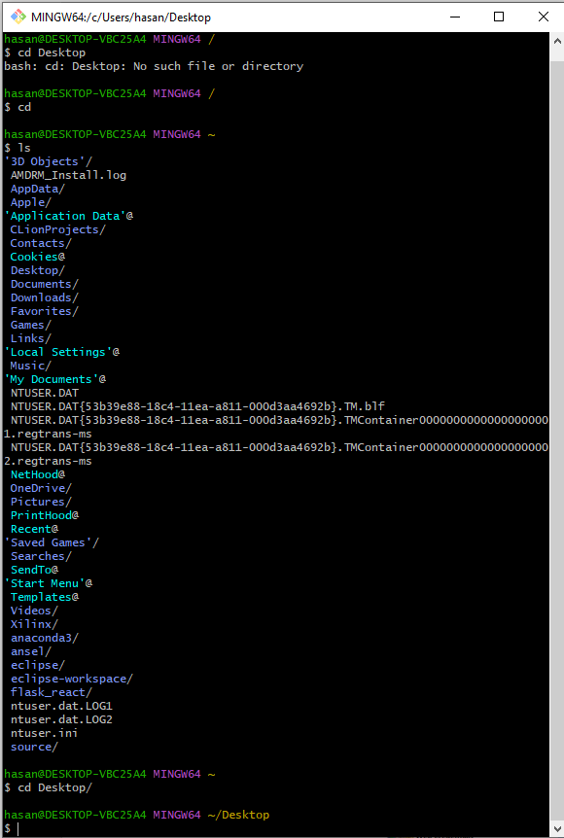
Open gitbash and “cd Desktop/”
After opening a new gitbash,type “ls”
See if you can see “Desktop/”
Type “cd Desktop/”
If you want to use a special folder to clone the repository then cd into that folder but for this example, we will cd into Desktop

Slide 5
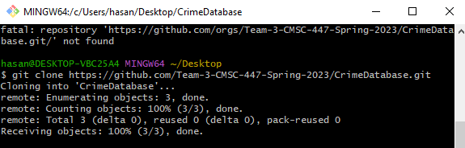
Git clone
Once you are in the level you want to be, type the command below
“git clone https://github.com/Team-3-CMSC-447-Spring-2023/CrimeDatabase.git”
This command clones the repository “CrimeDatabase” from our github into your desktop or whatever folder you are in.
If you open Desktop in file explorer, you will see CrimeDatabase

Slide 6
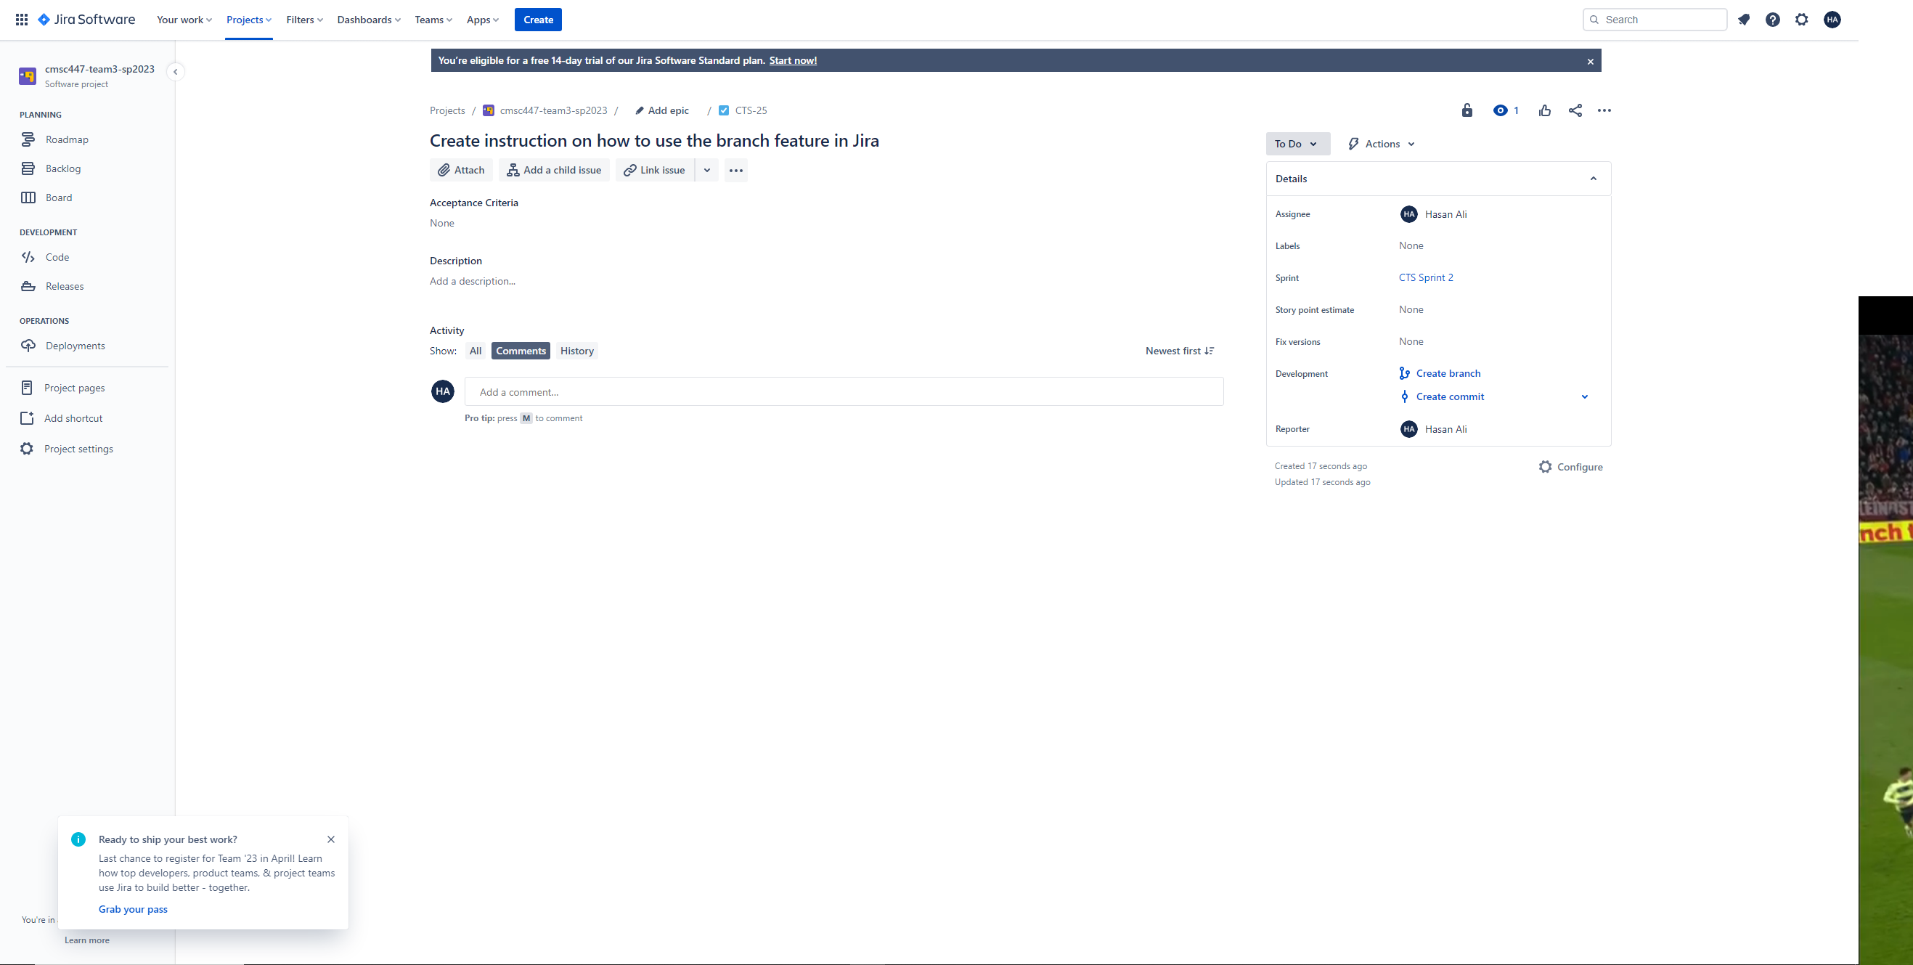
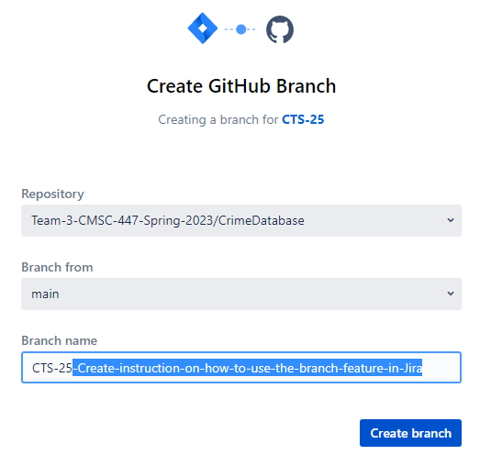
Creating a Branch
Go to the jira ticket and click create a branch
Pick CrimeDatabase as the repository. In this example we will chose CrimeDatabase but you can use any repository you want to make changes in. For example if we have a repo inside CrimeDatabase called “documents” and you want to make changes to that folder, then you choose documents as the repository
Make sure you select “main” for Branch from
Name the branch anything but best practice is to just name it the jira ticket. In the screenshot, I will erase the highlighted part and name it only CTS-25

Slide 7
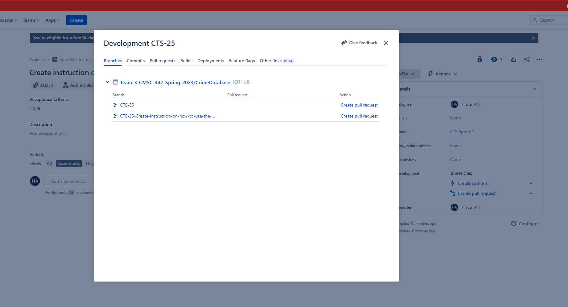
Branch on Jira Ticket
On the right side you see 2 branches, this is because I made two branches by mistake.
If you click on it the branches will show up, if you want to check the changes you made you can click on the branch name

Slide 8
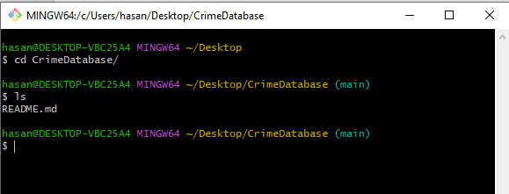
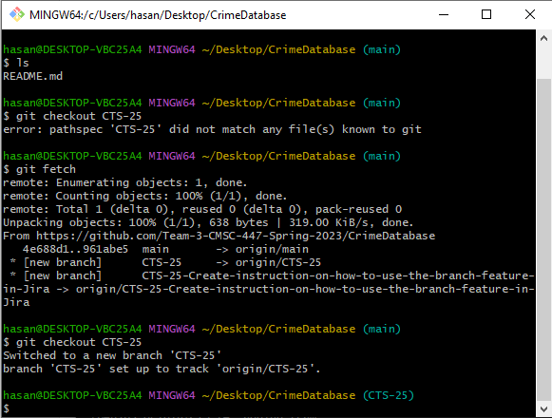
Branch Checkout
Open gitbash and cd into the CrimeDatabase.
You will see that it says (main) in blue, we need to change that
Type “git fetch”. This will fetch the newest branch in gitbash if not already. Usually if you clone the repository after creating the branch, you won’t have to git fetch
After fetching the newest branch, if necessary, type “git checkout branch-name”.
The branch name is the one you gave when creating the branch so in my example I will type
Git checkout CTS-25
See how it says (CTS-25) in blue now. This is saying that now whatever changes you make in CrimeDatabase or whatever repository you make the branch, it will not change the main repository in github until it has been merged

Slide 9
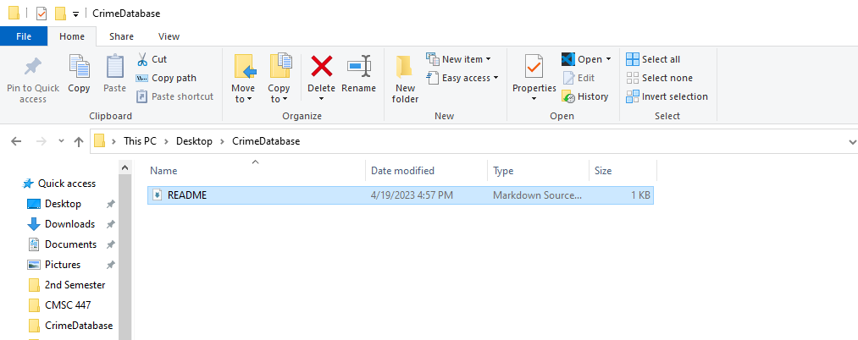
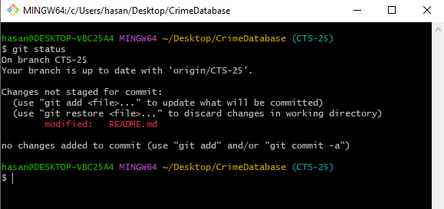
Open the CrimeDatabase
In file explorer, find where you cloned CrimeDatabse
Open it and open readme
In readme, type your name and hit save.
In git bash type “git status”
This command tells you any changes you have made
See how it says in red that README.md has been modified
If you accidentally made that change and don’t want gitbash to track that and resotre to the original type “git restore file-name” file-name will be the name of the file you want to restore. So “git restore README.md”
If you want to make the changes you made be committed so jira can see it, you will need to add it and then commit.
“git add file-name” file-name = README.md so type “git add README.md”

Slide 10
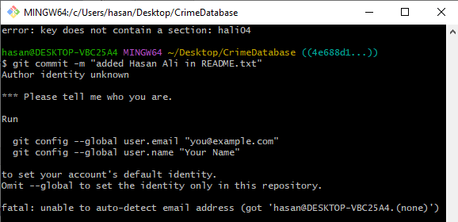
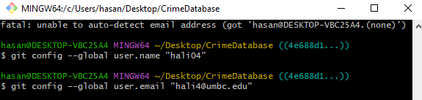
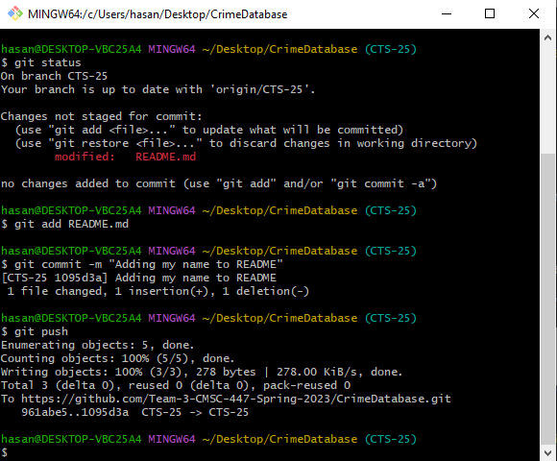
Commit and push
After adding the new changes, we want to commit it.
Type the command “git commit –m “enter a short text summarizing the changes made”. So for my example I will type “git commit –m “Adding my name in README”
Now you might run into the problem shown in the first screenshot. This is asking to enter the email and name. I choose to enter my email that I am using for github. The commands as shown in the screenshot. Type:
git config –global user.email “your email”
git config –global user.name “your name”
Now type in the commit command again
“git commit –m “Adding my name in README”
Now we want to push the commit to jira so jira can see it
git push

Slide 11
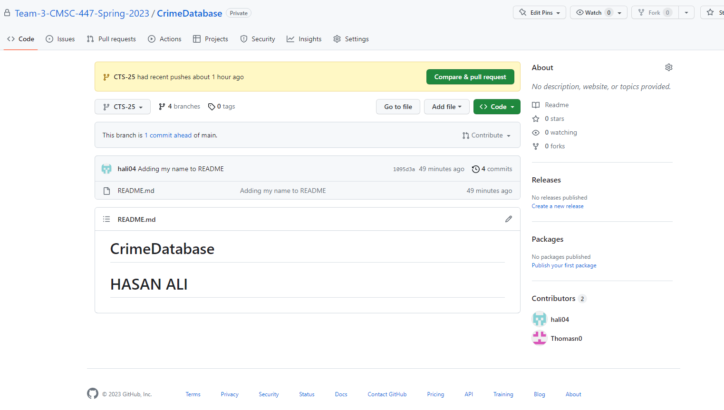
Jira
Go back to the jira ticket and click on the branches. Select the branch and it should open up a new tab.
Click on compare and pull request, then create pull request and then merge pull request and confirm merge.
You are done. The changes you made on the branch is now in main repository. So now when you check the github repository of CrimeDatabase, you will see your new changes.
The purpose of branches is to allow simultaneous work to co-exist without disturbing one another.

Slide 12
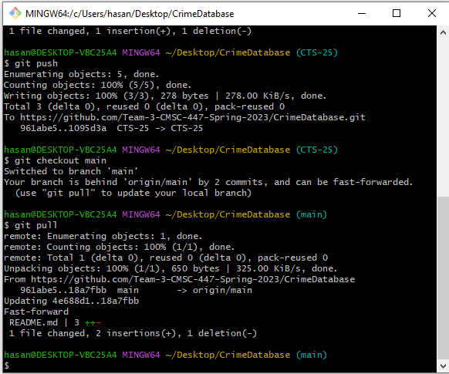
Checkout and Pull
In gitbash, checkout of the branch by typing the command “git checkout main”
The most important thing to know is that this will go back to the CrimeDatabase before you started the ticket. In order to update the Repository, you can simply delete the repository and clone again or you can go to the CrimeDatabase level in gitbash and type “git pull”. This will update the repository to the newest version
You can see from the screenshot, I went back to main and after typing git pull, it pulled the new merges from github and updates my local repository.
You are done. Any questions ask me.

